Slide 1


CYBR644 – Cyber Practitioner Lab
Spring 2024
University of Maryland, Baltimore County
Michael Hennick

Slide 2
Overview of the course
Week 01 – Introduction, Ethical Hacking Basics, Ethics, Law
Week 02 – Technical Foundations of Hacking
Week 03 – Reconnaissance, Social Media
Week 04 – Scanning and Probing
Week 05 – Vulnerability Identification
Week 06 – Exploiting Weaknesses
Week 07 – Class Presentations / Review for Exam
Week 08 – Spring Break
Week 09 – Midterm Exam
Week 10 – Privilege Escalation, Maintaining Access
Week 11 – Malware, Covering your Tracks
Week 12 – The Web
Week 13 – Wireless and Mobile Security
Week 14 – Physical Security, Social Engineering, and Security Policies
Week 15 – Class Presentations / Review for Exam
Week 16 – Final Exam

Slide 3
MIDTERM
Statistics
Completion times:
10-97 minutes (120 minute max)
~12 seconds per question - ~2 minutes per question
CEH: 125 questions / 240 minutes = ~<30 seconds per question
PenTest+: 85 / 165 minutes = ~<30 seconds per question
Scores:

Slide 4
Project 2
Two options
Option 1:
Perform research on an information security (cyber security) tool. This could be a deeper dive on the tools we've discussed in class, or you can present on a tool we haven't used/discussed. Whatever tool you choose, please answer the following areas:
1. Background on the tool, such as developer and whether it is "active" as far as being developed and updated.
2. Tool's usage, including a couple use cases on why you would select the tool during a penetration test, or in responding to an incident.
3. Screenshots or demonstration of the tool in use.
4. Comparison of the tool with other's that do similar functions.
Option 2:
Perform a penetration test against all four of the Victim VMs. As you perform the penetration test, be sure to outline the discovery of the systems, what services were found, the vulnerabilities found, and the exploits used. Be sure to also include remediations and recommendations for the vulnerabilities and exploits that you document.
For the report, you can follow a template from Offensive Security (https://www.offensive-security.com/reports/sample-penetration-testing-report.pdf ) or from SANS (https://www.sans.org/reading-room/whitepapers/testing/writing-penetration-testing-report-33343 ), or a combination of the two.

Slide 5
Where are we?
Phase 1 provided us with information on our target
Network Ranges, Key systems of interest, Technologies Used,
Insight into potential attack vectors, Insight into potential passwords
Phase 2 provided us additional information on our target
Active systems, Ports/Services, Versions of applications running,
Versions of Operating Systems
Phase 3 provided us with known vulnerabilities to the services/systems of our target
Patches that weren’t applied, old versions of software
Insecure services, un-configured services
Phase 4 provided us access to the target systems to help reach end goal
Deface webserver
Dump or steal database of customer records
Steal sensitive files
Look for additional systems to compromise

Slide 6
Take A Step Back…
6. Hide/Cover Tracks
1. Reconnaissance
5. Maintain Access
2. Network Discovery
4. Compromise Targets
2. Host/Port Discovery
3. Vulnerability Identification
3.Application Identification

Slide 7
Maintain Access/gain foothold
Now that we’ve gained access to a system….
- Create a form of legitimate access
- Monitor activity for signs of investigation
- Change network behavior to affect other users/systems
- Create a scheduled event to send data to us periodically
- Create a service/process that allows for access beyond throwing an exploit

Slide 8
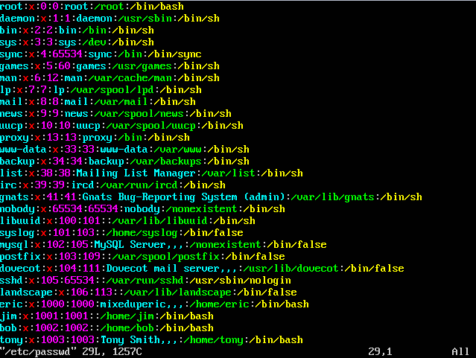
Legitimate Access
User account/password
that you know
Usually named to match
other employee accounts
or service accounts

Slide 9
Beyond heap/buffer exploits
Most Heap/Buffer overflow exploits are patchable
Systems Administrator just needs to apply the patch, or vendor fix
Network Administrator just needs to apply ACLs or firewall rules to block access to suspect resource/port
Password Cracking
Once you get a copy of the password files, it’s just a matter of time
Windows – SAM database
Linux/Unix - /etc/password and /etc/shadow files
Mitigation relies on users actually implementing strong passwords or passphrases
Password policies just delay the cracking
Password Bruteforcing
Very time consuming as long as strong passwords are in place
Very noisy if Systems Administrator turns on logging and alerting

Slide 10
Passwords
Common Password Issues
- Dictionary based
- Personally based
- Easy to remember
Password Components
- Upper Case Characters
- Lower Case Characters
- Punctuation/ Special Symbol Characters
- Numeric Characters
A good password contains 3 of the 4 components and is at least 8 characters long.
A BETTER password contains all 4 components!!

Slide 11
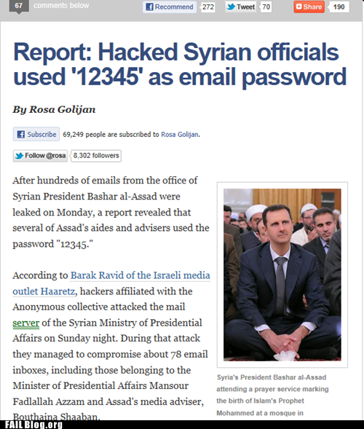
Do’s and Don’ts of passwords
Simple sequences
abc123
qwerty
12345
Personal
Children’s names
Maiden names
Pet’s names
Employer
School
Car

Slide 12
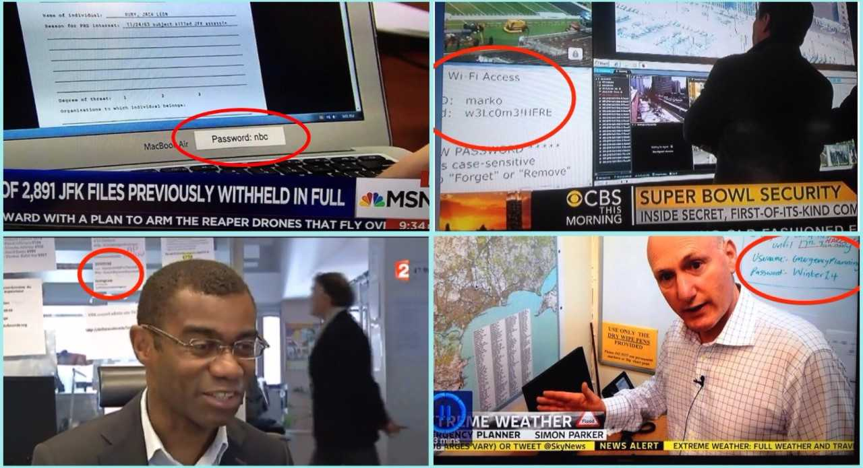
Do’s and Don’ts of passwords

Slide 13
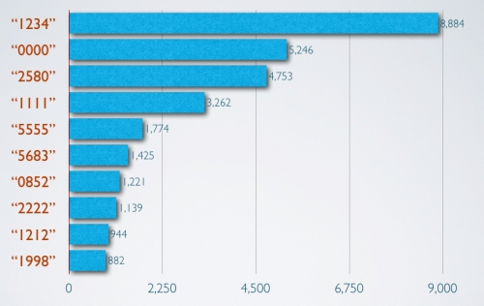
Password Strength
PIN CODE strength survey 2011

Slide 14
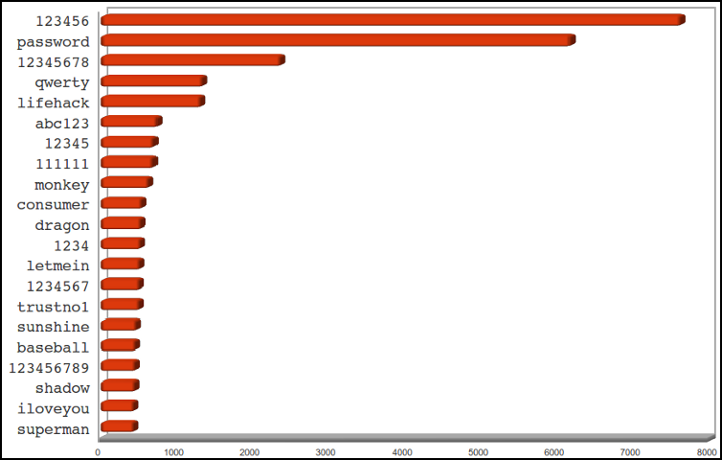
Password Strength
Analysis of gawker media servers passwords after hack 2011

Slide 15
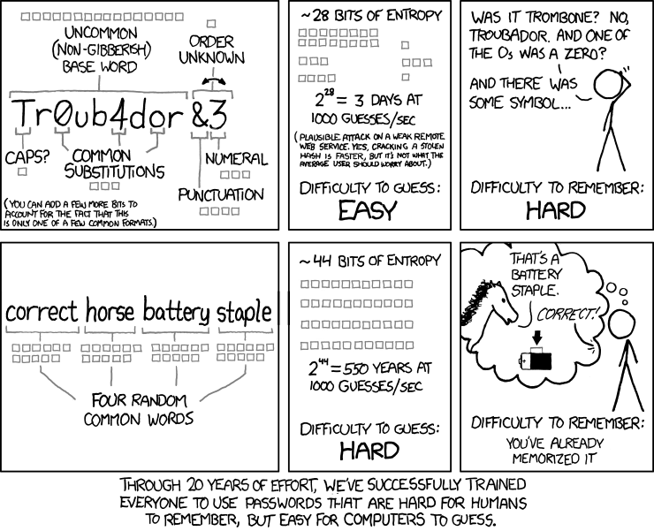
Password Complexity

Slide 16
Types of password cracking
Online
Trying to figure out the passwords on a system you do not have access to
Hopefully it is fairly time intensive since you may be limited on how many incorrect guesses you have
Usually is very noisy, (creates lots of logs and warnings)
Offline
Trying to figure out user passwords when you have read access to the password files
Much, much faster than online password cracking
It can often be done on a different system, so it doesn’t create failed login attempt logs
16

Slide 17
Why would you want to do offline password cracking?
You already have root, or at least have the ability to read the hard drive to grab the password file
Yes, but if you want to read encrypted files you still need the real password
People often use the same password on several different computers
Often you can grab passwords to non-local devices that you might not have access to, such as domain passwords
You might not want to alert the target by blanking their password
17

Slide 18
Owning the Box
When attackers have access to the computer, they can compromise other user accounts:
Obtaining SAM:
Stores user passwords in hashed form
Encrypted
Could reset passwords if they have physical access to the machine.

Slide 19
Files you want to grab off of the hard drive of a Windows machine
SAM File
Usually stored in C:\Windows\System32\config\SAM
Reason: This file stores the local passwords
SYSTEM File
Usually stored in C:\Windows\System32\config\SYSTEM
Reason: This file is used to decrypt the SAM file
SHADOW file
Usually stored in C:\Windows\System32\config\SHADOW
Reason: This file stores the Domain passwords
19

Slide 20
Password Cracking
Password Crackers
John the Ripper - UNIX password cracker for DOS, Win95, UNIX and NT LanMan
Ophcrack – Linux, Mac and Windows password cracker based on rainbow tables. It is a very efficient implementation of rainbow tables done by the inventors of the method.
Lcp - computes user passwords from cryptographic hashes
Cain & Abel – includes a bunch of password crackers among its other networking tools
PWDUMP – command line tool that can bypass SYSKEY encryption
Nutcracker - dictionary and brute force attacks
Crackerjack - encrypted UNIX passwords
20

Slide 21
Authentication Types
LM authentication:
Used by Windows 95/98/Me
Based on DES
Easy to crack
Could still be used for backward compatibility
NTLM authentication:
Used by Windows NT before service pack 3
Based on DES and MD4
NTLM v2:
Based on MD4 and HMAC-MD5
Kerberos:
Windows 2000 and later

Slide 22
Types of Windows Hashes
LanMan
Is still used by default to provide backwards compatibility with Windows 98 machines
Takes your password, breaks it up into two 7 character passwords, capitalizes the letters and then hashes them
Very, very weak. Can be broken in minutes with rainbow tables
22

Slide 23
NTLM Hash
Much stronger than LanMan
It is case sensitive
It doesn’t break up the password like LanMan
Still vulnerable to rainbow tables
There are publicly available rainbow tables that can break up to a 7 character password, or 8 characters if only text and numbers are used
Sponsored hackers probably have much more complete rainbow tables
23

Slide 24
MSCache Hashes
Windows Domain Hashes
Very Secure
By default, the last 10 domain users to log onto a computer have their credentials saved
This include administrators
24

Slide 25
How passwords work
User types in password
User creates password
Password123
Hash Algorithm
Password database
Password runs through the hashing algorithm
User: zkjfaoia324iujafh$

Slide 26
How passwords work
User logs in
Password123
Hash Algorithm
zkjfaoia324iujafh$
Compare hash to hash stored in database
Password database
User: zkjfaoia324iujafh$

Slide 27
Properties of a hash
Algorithm only goes one way, it is impossible to take the hash and figure out the password
Small change in the password, creates large change in the hash
Collisions should be minimized (two different passwords should rarely, if ever equal the same hash)
Hash should take as long as is reasonable to login

Slide 28
Password cracking with Hashes
Form of offline attack, assumes you have the password file
Because it is impossible to figure out password from hash, it is possible to try any number of combinations and compare hashes
Time consuming, but does work

Slide 29
Brute Force
aaaaa
Hash Algorithm
zkjfaoia324iujafh$
Compare
aaaab
Hash Algorithm
Ajfkahdjfjkfahdaf^
Compare
aaabc
Hash Algorithm
Dajadsfhjkaerbe%
Compare
Password database
…. etc
User: adsffj349afdnbj3k$

Slide 30
Dictionary Attack
cat
Hash Algorithm
zkjfaoia324iujafh$
Compare
dog
Hash Algorithm
Ajfkahdjfjkfahdaf^
Compare
airplane
Hash Algorithm
Dajadsfhjkaerbe%
Compare
Password database
…. etc
User: adsffj349afdnbj3k$

Slide 31
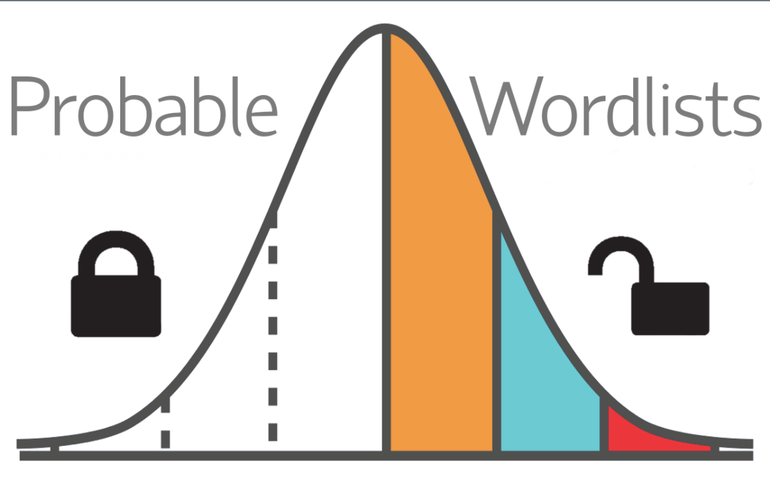
Wordlists
https://github.com/berzerk0/Probable-Wordlists

Slide 32

Rainbow Tables
Trade off between CPU and Storage
Compute all possible hashes once and store them in a large database
Then you can look up by hashes much quicker

Slide 33
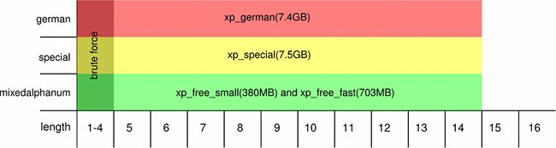
0phCracK
Free Windows Program that can crack Windows password obtained by:
When given administrative privileges to a machine
Physical access to a machine with a bootable CD
Sniffing on the network
Uses the Rainbow table concept
Multiple dictionaries of varying sizes available for free on their website
Very easy to use
Can be used to audit your own passwords

Slide 34


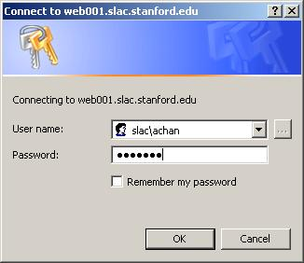
Network password cracking
Various network services require logins, if an attacker knows a user name they can try to login remotely with either brute force of Dictionary attacks
Process a lot slower, and very easy to detect
User: root
Password: cat
User: root
Password: dog

Slide 35
Hydra
Free Open Source application which can attack the following services:
TELNET, FTP, HTTP, HTTPS, HTTP-PROXY, SMB, SMBNT, MS-SQL, MYSQL, REXEC, RSH, RLOGIN, CVS, SNMP, SMTP-AUTH, SOCKS5, VNC, POP3, IMAP, NNTP, PCNFS, ICQ, SAP/R3, LDAP2, LDAP3, Postgres, Teamspeak, Cisco auth, Cisco enable, LDAP2, Cisco AAA
Uses a dictionary to try various passwords

Slide 36
BruteSSH
SSH is a tool to allow users and administrators to remotely login to servers
SSH is often made public to the Internet, so administrators can fix servers from home
Brute SSH performs a dictionary attack Unix server’s SSH service

Slide 37
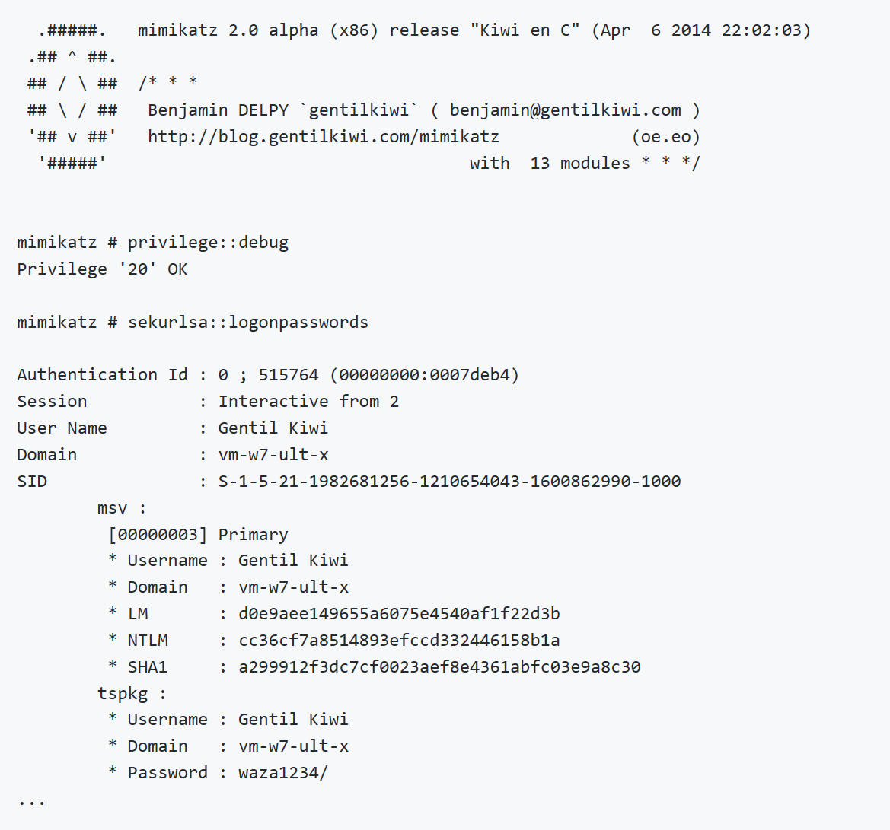
MImikatz
Post exploitation module built into Metepreter, as well as a standalone application
Unofficial Guide/Command Reference:
https://adsecurity.org/?page_id=1821
@gentilkiwi
https://github.com/gentilkiwi/mimikatz

Slide 38
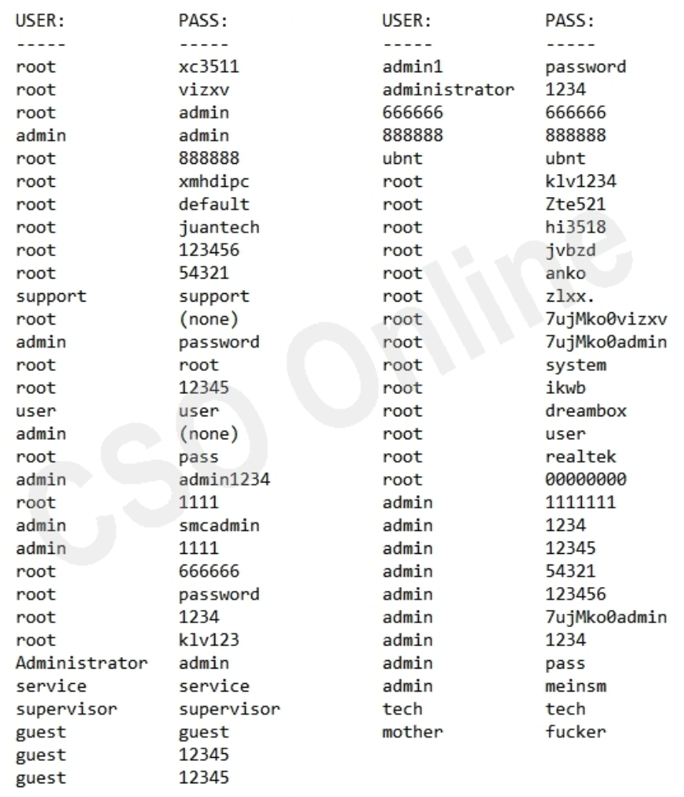
IOT Attacks
Default accounts that are permanent or un-editable in nature
Mirai is the perfect example

Slide 39
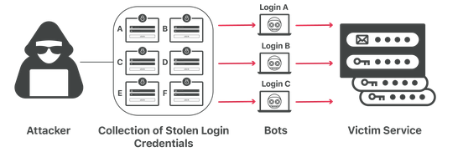
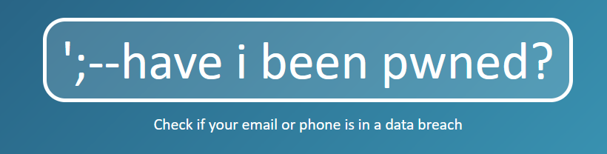
Credential Stuffing Attacks
Because humans reuse passwords, why not “try” to login with them on other systems…

Slide 40

Break

Slide 41
Owning the network
Now that we ‘pwn’ a system within our target, let’s go after the network
Network Domination
Sniffing
DNS/ARP Poisoning
MitM
Proxy
Mail relay
Data Exfiltration
ICMP
DNS
Other
Steganography

Slide 42
Packet Analyzing/Sniffing
All data on a network that is transmitted can be sniffed.
Web pages
Copying of files
Mail flow
DNS lookup
Network cards need to be put in “promiscuous mode” in order to listen to everything going on within the network.
Can be set with a literal “flip of a switch” via software
Network architecture needs to allow for “chatty” systems
Every node within a single LAN segment can see traffic of others on that segment

Slide 43
Sniffers
A program that could be used to collect information that goes through the network
Can place a host network card in promiscuous mode
Collects all packets that the system sees, not just the ones addressed to it
Passive:
Sniffing performed on a hub
Not common in most current network environments
Active:
Sniffing performed on a switched network
Use port mirroring or switch mirroring to collect all traffic that passes through the switch
Sniffers operate at the data link layer

Slide 44
Active Sniffing
The attacker must be either on the local network or at a point where traffic passes through.
Overcoming sniffing limitations on a switched network:
MAC flooding
ARP Poisoning

Slide 45
Tools for Sniffing
Wireshark
Displays multiple views of captured data:
Summary
Details
Hex
Filters can be set up to view specific types of traffic:
Capture filters
Display filters
CACE Pilot
Omnipeek
Dsniff
TCPdump
Windump

Slide 46
Address Resolution Protocol (ARP)
ARP resolves known IP addresses to unknown MAC addresses.
ARP communication consists of two message types:
ARP request
ARP reply
Does not verify the responding device is who it says it is.
ARP cache:
Stores the IP address, MAC address, and time of each entry.
Run arp – a command to see the ARP cache.

Slide 47
DNS/ARP Poisoning
ARP – Address Resolution Protocol
Four basic message types:
An ARP Request. Computer A asks the network, "Who has this IP address?"
An ARP Reply. Computer B tells Computer A, "I have that IP. My MAC address is [whatever it is]."
A Reverse ARP Request (RARP). Same concept as ARP Request, but Computer A asks, "Who has this MAC address?"
A RARP Reply. Computer B tells Computer A, "I have that MAC. My IP address is [whatever it is]“
DNS – Domain Name Service
Translates a DNS Name (www.umbc.edu) to an IP address on the internet/network.
If the name has already been queried for, the result is cached in order to improve efficiency.

Slide 48
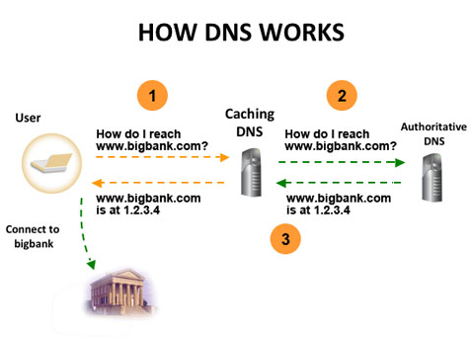
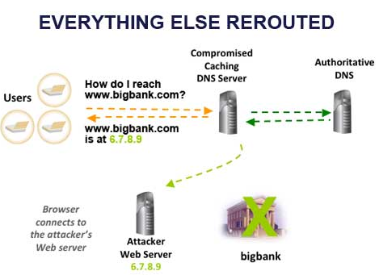
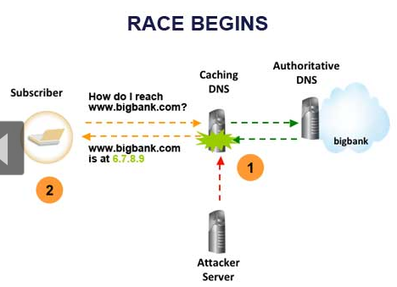
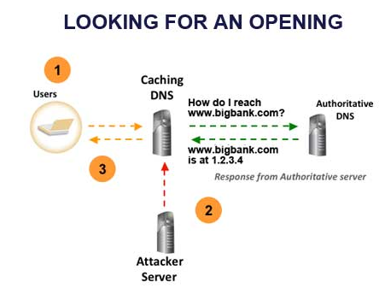
Dns pOISONING

Slide 49
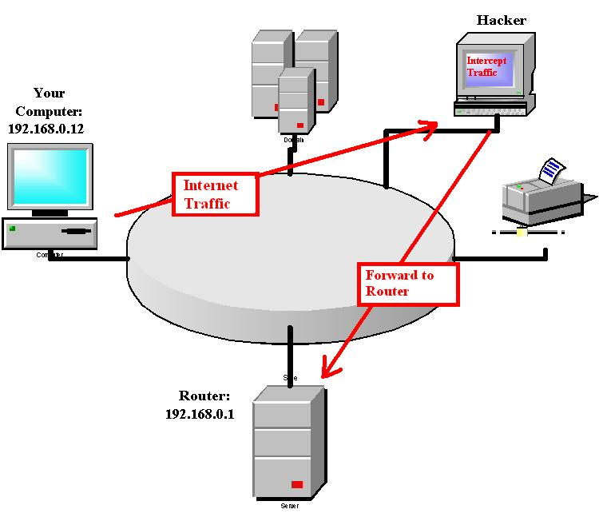
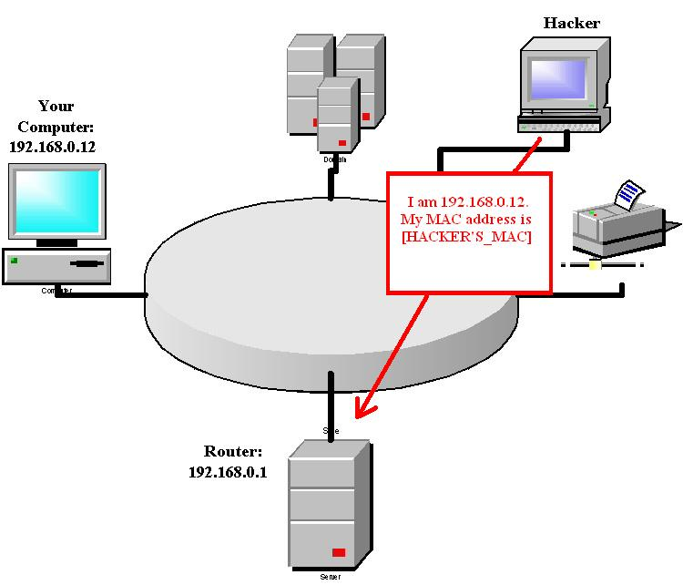
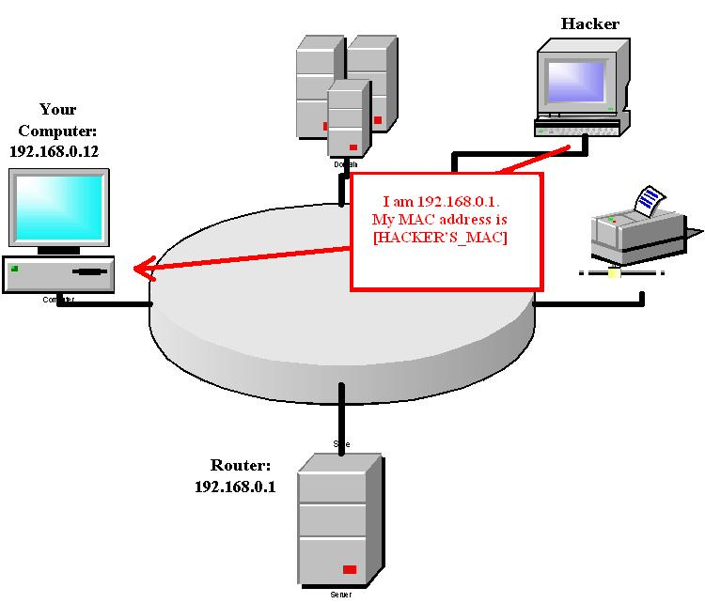
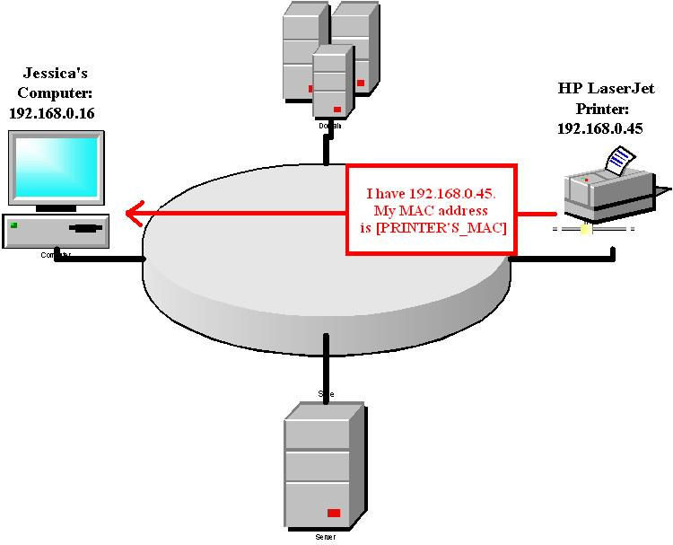
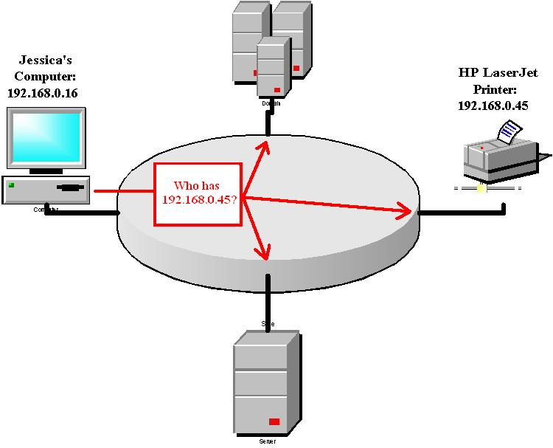
Arp pOISONING

Slide 50
Man in the middle (mITm)
After successful ARP/DNS poisoning, an attacker can perform a MitM attack by facilitating services on the network that are intended for other (legitimate) systems.
Web Proxy
Stand up an attacker system with Squid and impersonate the legitimate web proxy
Mail Relay
Stand up an attacker system with Sendmail and impersonate the internal mail relay server

Slide 51
MAC flooding
Seek to overload the switch content addressable memory (CAM) table.
Frames start flooding all ports on the switch.
Drawbacks:
Generates a lot of network traffic
Requires a second machine to perform the capture
Tools:
EtherFlood
SMAC
Macof
Other techniques:
DHCP starvation
DHCP snooping

Slide 52
Countermeasures
Implement port security:
Configure each switch with the MAC address of devices allowed to send/receive traffic.
Known as Dynamic ARP Inspection (DAI) in Cisco devices.
IP Source Guard:
Restricts IP traffic on untrusted Layer 2 ports
Can be time-consuming on large networks.
Use encryption:
IPsec, VPNs, SSL, and PKI
Arpwatch tool:
Keeps track of ethernet/ip address pairings and reports unusual traffic
Build static ARP entries:
Inefficient and time-consuming

Slide 53
Session Hijacking
Exploiting a weakness in TCP and network communication and taking over the connection
Has a sniffing component but the attacker injects packets into the network
Steps:
Identify an active session.
Predict the sequence number.
Take one of the parties offline.
Take control of the session.

Slide 54
Identifying an Active Session
First step in session hijacking process
Easier if attacker and victim are on the same network segment:
Passive sniffing if there is a hub
Active sniffing if there is a switch
Challenging task when on a different segment:
Attacker needs to do blind sequence number prediction.
Attacker can send packets to the server to sample sequence numbers.

Slide 55
Predict Sequence Numbers
Every byte of data transmitted with TCP must have a sequence number:
Used to keep track of data and support reliability
Attackers need to predict the sequence number so that they can inject packets before the session ends.
Prediction results depend on the OS.
Could use tools such as Nmap, Ettercap, and Hunt.

Slide 56
Session Hijacking
The hackers goal is to take the user offline after they predict the sequence number.
Denial-of-service
Source routing attacks
Tricks server that the hacker is the legitimate user
The attacker takes control of the session and uses the connection to execute the commands.

Slide 57
Application Layer Hijacking
Objective is to steal or predict a session token
Techniques
Session sniffing
Predictable session token ID
Man-in-the-middle attacks
Man–in–the–browser attacks
Client-side attacks

Slide 58
Session Hijacking Tools
Ettercap
Hunt
TTY Watcher
IP Watcher
T-Sight
Application layer session hijacking
Firesheep
Hamster
Session thief
Temper IE

Slide 59
Preventing Session Hijacking
Two main methods:
Prevention:
Limiting incoming connections.
Rejecting Internet packets that originate from a local address.
Use encryption.
Disable FTP and Telnet if not needed or use SSH.
Detection

Slide 60
Denial-of-Service
Targets the availability of a system or network
Types of DoS:
Bandwidth consumption:
Blocks a machine or a group of machines from using network bandwidth
Smurf
Fraggle
Chargen
SYN Flood attacks:
Directs the flood of traffic at an individual service on a machine
Type of resource starvation attack
SYN flood – sends large number of packets with SYN flag set
Program and application attacks:
Causes a critical error on a machine to halt its capability of operating
Ping of Death
Teardrop
Land

Slide 61
Distributed Denial-of-Service
Similar to DoS but the attacker uses multiple machines to carry out the attack
Two phases:
Preattack:
Attacker compromises other computers to act as masters and zombies.
Puts a distance between the attacker’s machine and the targeted system.
Actual attack:
The master instructs zombies to start the attack.
Two components of DDoS attack:
Software:
Client software
Daemon software
Hardware:
Master
Zombie
Target

Slide 62
DDoS Tools
Tribal Flood Network (TFN):
UNIX-based tool
Can be used to launch ICMP, Smurf, UDP, and SYN flood attacks
Master uses UDP port 31335 and TCP port 27665
Trinoo:
Launches a coordinated UDP flood attack
Easy to use
Stacheldraht:
A hybrid between TFN and Trinoo
Uses encryption
Uses TCP port 16660 by default
TFN2K
WinTrinoo
Shaft
MStream
Trinity

Slide 63
DoS, DDoS, and Botnet Countermeasures
Use principle of least privilege.
Close unused ports.
Disable nonessential services.
Implement bandwidth limitation.
Apply the latest patches and security fixes.
Allow only necessary traffic.
Egress filtering.
Use IDS.

Slide 64
Data Exfiltration
Also known as data extrusion, it is the act of data leaving a network via means that it shouldn’t.
Examples:
ICMP Packets
DNS Packets
HTTP Packets
SSH Tunnel Packets

Slide 65
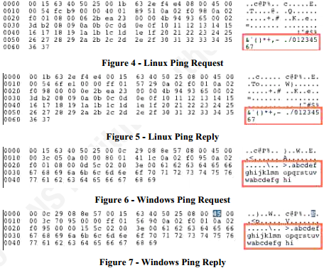
Data Exfiltration
ICMP Exfiltration

Slide 66
Data Exfiltration
DNS Exfiltration

Slide 67
Data Exfiltration
HTTP Exfiltration

Slide 68
Steganography
“The art and science of writing hidden messages in such a way that no one, apart from the sender and intended recipient, suspects the existence of the message, a form of security through obscurity”
~ Wikipedia
In digital steganography, electronic communications may include steganographic coding inside of a transport layer, such as a document file, image file, program or protocol. Media files are ideal for steganographic transmission because of their large size.
As a simple example, a sender might start with an innocuous image file and adjust the color of every 100th pixel to correspond to a letter in the alphabet, a change so subtle that someone not specifically looking for it is unlikely to notice it.

Slide 69

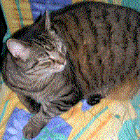
Steganography
Original Image Hidden Image
The hidden image is revealed by removing all but the two least significant bits of each color component and a subsequent normalization.

Slide 70
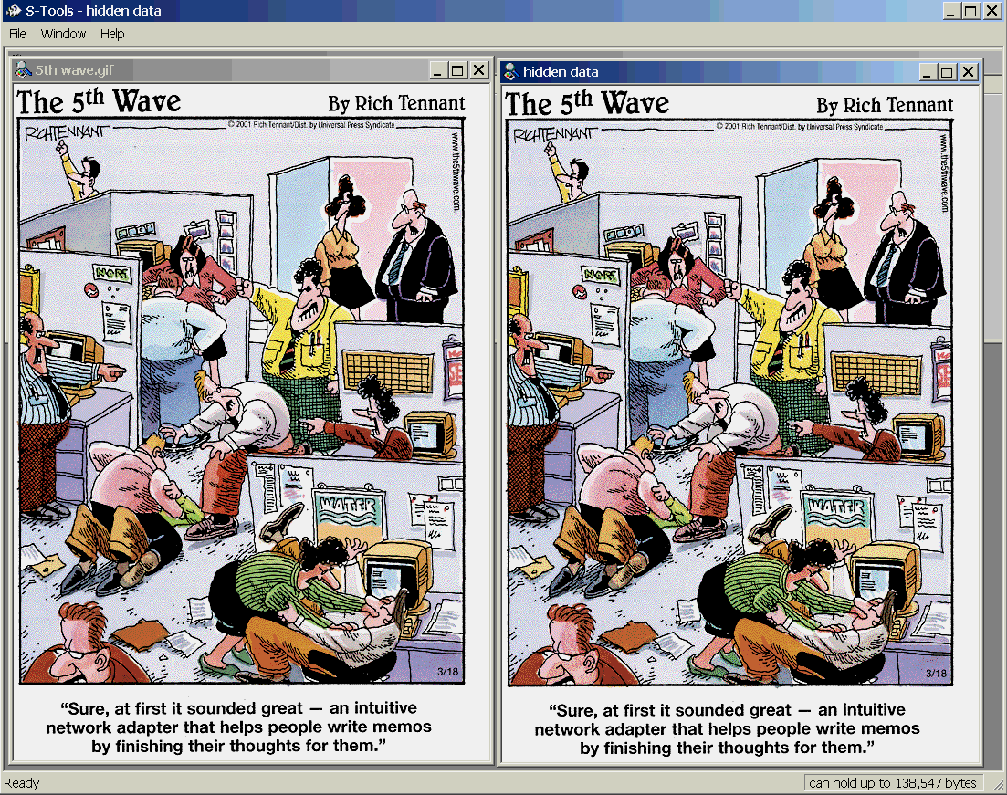
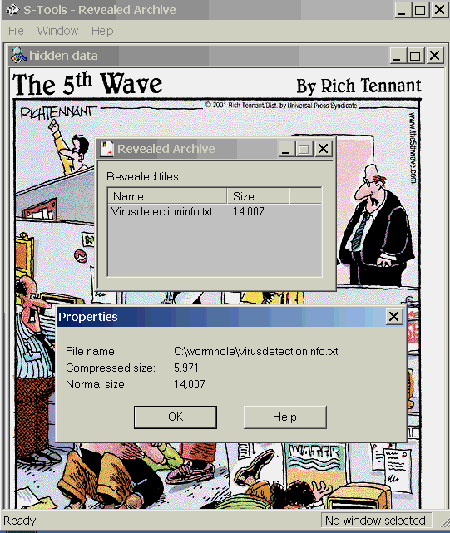
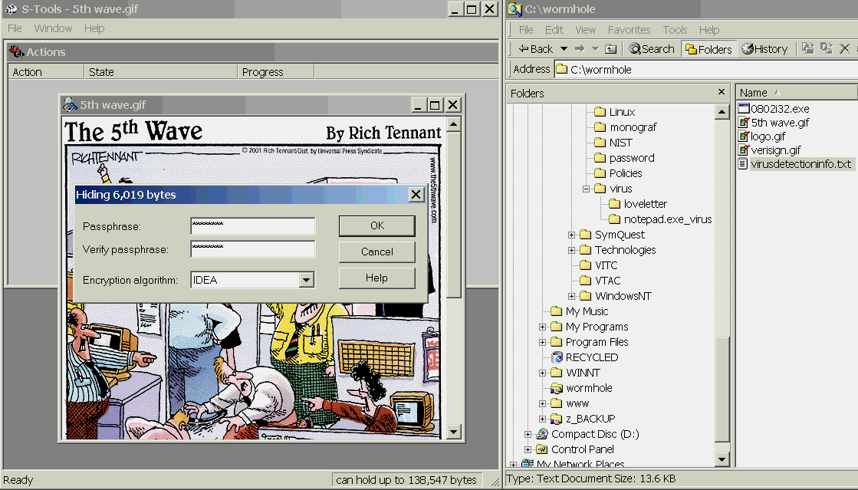
Steganography

Slide 71
Alternate Data Streams (ADS)
Feature of Windows New Technology File System (NTFS) that contains metadata for locating a specific file by author or title. ADS is supported by all versions of Windows beginning with Windows NT through the current version.
As a hacker, ADS can be used to “hide” documents within files that can then be transferred and may be overlooked by a system admin or investigator.

Slide 72
Perspectives
Attacker Perspective
1. Sniff network traffic to learn additional information on target
2. Install rogue wireless access points to deceive wireless clients to connect to your network instead of the legitimate resources
3. Poison the ARP/DNS cache to perform a MitM attack
4. Impersonate the target’s web proxy or mail relay server to get more information and/or redirect/modify legitimate traffic
5. Steal any data that is useful via a covert channel such as DNS packets, or hide within a media file
…LEARN… + ATTACK!!!!!!

Slide 73
Perspectives
Defender Perspective
1. Sniff network activity in order to look for anomalous activity
2. Monitor wireless infrastructure to keep any eye out for rogue devices
3. Implement enterprise SSL on key systems in order to ensure network connections occur with only “known” systems
4. Monitor network packets for abnormal sizes
5. Look for “larger than normal” files on the network that may be suspect
…VERIFY… + MONITOR

Slide 74
Perspectives
Investigator Perspective
1. Perform network forensics with sniffing/packet analysis tools
2. Compare MAC addresses of “known good” devices with those found during an incident
3. Compare network traffic/logs of suspect systems against a baseline of “regular” activity
4. Compare packet sizes of “normal” traffic types against those found during an incident
5. Run suspect files against Steganography tools
…COMPARE…

Slide 75
Summary
Passwords
Components
Password Cracking
Bruteforce
Dictionary
Rainbow Tables
Network Domination
Explain Sniffing (Active/Passive)
DNS/ARP Poisoning
Mac Floding
MitM
Session Hijacking
DoS, DDoS, Botnets
Data Exfiltration
ICMP
DNS
Other
Steganography
Countermeasures

Slide 76
Lab

